Slide 1
Movie recommendation system:

Slide 2
Team members:
AKHIL JANARDHANAN
JIS MATHEW
JISHNU GOPI
NITHIN JOY
RAMESH KRISHNAN

Slide 3
What is recommendation system:
A recommendation system is a subclass of information filtering system that seeks to predict the "rating" or "preference" a user would give to an item. They are primarily used in commercial applications.
Recommender systems are utilized in a variety of areas, and are most commonly recognized as playlist generators for video and music services like Netflix, YouTube and Spotify, product recommenders for services such as Amazon, or content recommenders for social media platforms such as Facebook and Twitter

Slide 4
Movie recommendation system:
GOAL :
Search for movie, find movie what to watch based on genre comments and user ratings and when you have watched a movie to find other movies similar to it.
System takes into consideration genres the watched movie belongs to and therefore it recommends you the top movie based on user's watch counter from each genre the movie was in.

Slide 5
Source of our movie dataset:
The dataset used for this project is from Kaggle .
DOWNLOAD IT FROM
https://www.kaggle.com/rounakbanik/the-movies-dataset

Slide 6
Dataset:
The experiment is conducted by structuring the ratings column of the dataset.
It consists of 100004 ratings by 671 users across 9125movies. The ratings allowed at intervals of 0.5 on a 5-point scale.
All users had rated at least 20 movies. Each user is represented by an id, and no other information is provided. The dataset has additional information about the movies in the form of genre and tags.

Slide 7
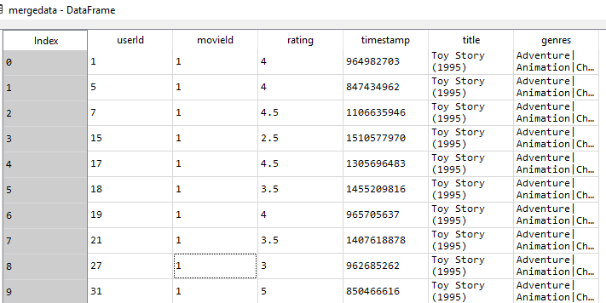
STRUCTERED DATA ANALYSIS:

Slide 8
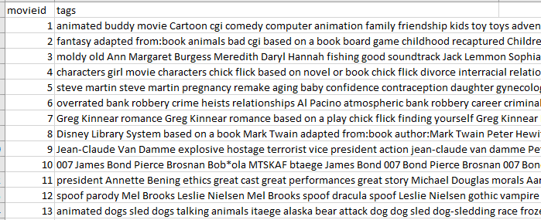
MOVIE TAGS:

Slide 9
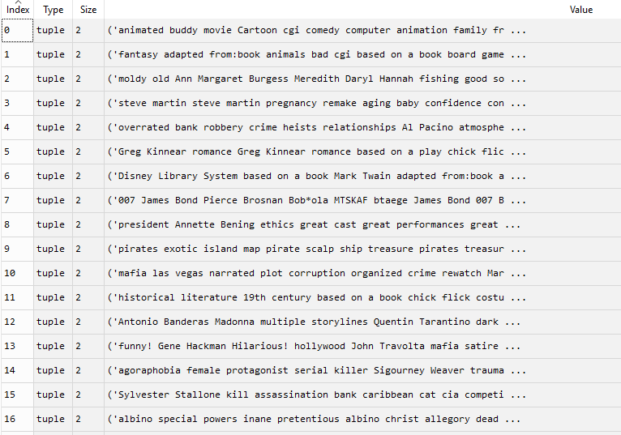
TRAIN DATA (TAGS,Rating):

Slide 10
MACHINE LEARNING:
The movies are identified based on their tags . Here we took ratings along with movie tags for train of data.
The movie with user rating above 3 is classified as a liked preference .
Also rating below 3 is taken as not much likely preferred by the user.
We then used this concept to train the model .
The model so built is capable of predicting whether a movie is likely to be preferred by the user based on the movie tags.

Slide 11
ALGORITHM USED:
Naive Bayes classifier:
Naive Bayes classifiers are highly scalable, requiring a number of parameters linear in the number of variables (features/predictors) in a learning problem.
Maximum-likelihood training can be done by evaluating a closed-form expression which takes linear time, rather than by expensive iterative approximation as used for many other types of classifiers.

Slide 12
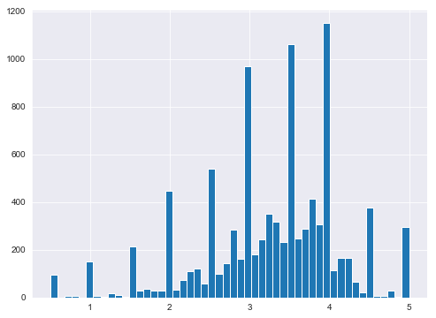
PLOT(USER VERSUS RATING ON SCALE 5):

Slide 13
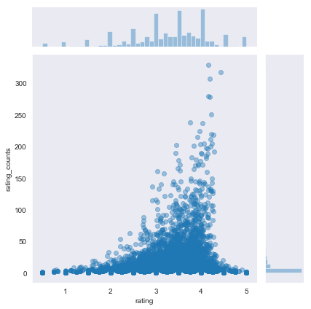
ML PLOT:

Slide 14
From the plot we learnt the rating a user given based on tags.
The learnt user is interested in fantasy movie as he has given rating greater than 4 scale on that category tag.
As par from the learning , the recommendation system understood the user’s taste and improved likelihood by adding features to suggest movies with common actors, directors , plot etc.

Slide 15
CONCLUSION:
Movies released within the same time period could also receive a boost in likelihood for recommendation.
Similarly, the movies total gross could be used to identify a users taste in terms of whether he/she prefers large release blockbusters, or smaller indie films.
However, the above ideas may lead to overfitting, given that a users taste can be highly varied and we only have a guarantee that 20 movies (less than 0.2%) have been reviewed by the user

